Slide 1
DERIVED PARAMETERS OF HAMILTON - C1 & GETINGE SERVO – C VENTILATORS
PREPARED BY
HARIHARAN S
AEROBIOSYS. INNOVATIONS. PVT. LTD.

Slide 2
EXTRACTS FROM HAMILTON C1 VENTILATOR:
The certain derived dynamic parameters of the Hamilton – C1 ventilators are been listed below as follows:
PPEAK – CmH2O
Pplateau – CmH2O
Pmean – CmH2O
PEEP – CmH2O
P0.1 – CmH2O
PTP – CmH2O
Autopeep – CmH2O
Inspiratory flow – lit/min
Expiratory flow – lit/min
Vti - ml
VTE (spont)
Expiratory Minute Volume
MV (spont)
f Total ( b/min)
f Spont (b/min)
Ti, Te, I:E
Vt / BW (ml/kg)
Rinsp (CmH20/l/s)
Cstat (ml/cmH2O)
Rexp (seconds)
Vleak (%)

Slide 3
MV Leak (l/min)
Oxygen (%)
P(cuff) – CmH2O
SPECIFIC FOR SPO2 SENSOR CONNECTED CONDITION:
Pulse (l/min)
SPO2 %
SPECIFIC FOR CO2 ELIMINATION CONDITION:
Vdaw (ml)
Slope CO2 (%CO2/lit)
Vtalv (ml)
Valv (l/min)
Vdaw / VTE (%)
PetCO2 (mmHg)
FetCO2 (%)
VeCO2 (ml)
V ‘CO2 (ml/min)

Slide 4
GETINGE – C1 VENTILATOR EXTRACTS:
PBW / VT (ml/kg)
Target volume (ml/kg)
Mve (l/min)
Trigger (l/min)
Pmean (CmH2O)
FLOWee (b/min)
RRsp (b/min)
WOPvent ()
Cstatic (ml/CmH2O)
Pdrive (CmH2O)
E (CmH2O/l)
Re (CmH2O/ l/s)
Ri
O2 boost (100%)
Pplateau (CmH2O)
Te (s)

Slide 5
FOR ALERT BASED CONTENT FROM EXTRACTS:
I was assigned to examine the way the alerts get popped up and the cause for the alert
I watched certain resources where they deal with the Priorities of the alerts but not able to find the causes related one.
In Getinge ventilators:
The alert message shows up the Alert name alongside with the cause of alarm & checklist to overcome the alert at that moment.
For example:
Alert : Expiratory minute volume low
Cause : rate is high.
Checklist : Check patient, patients’s circuit and ventilator settings.

Slide 6
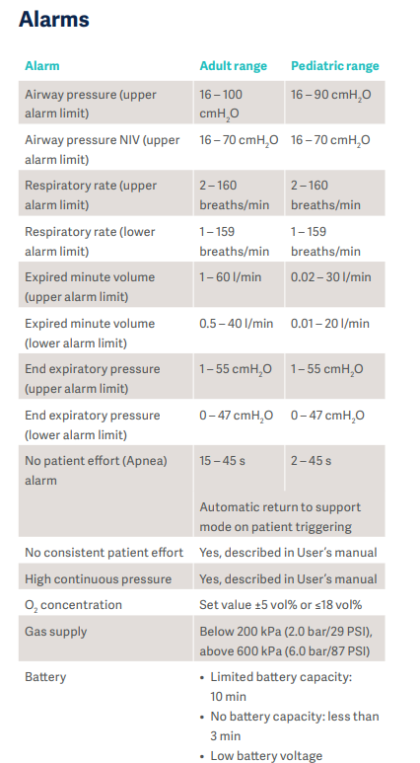
ALERT PARAMETERS:
Check flow sensor for water alarm :
Begins as medium priority and if not acknowledged within 60 seconds turns to be a high priority alarm.(only in neonate case).
Note: I Hamilton C1 the alarm sound used has different sound rythm for different priorities.
I had also gathered a certain alert ranges for the parameter considerations of the ventilators and they are given below as follows:
These data were arrived from the Getinge ventilator manuals.

Slide 7
High pressure alert:
Occurs when the Peak Inspiratory Pressure (PIP) is more than the High Pressure alarm that is set on the ventilator. This means there is increased pressure in the lungs.
Low minute ventilation:
Occurs when the low minute volume alarm that is set on the ventilator is lower than what the child is doing. Minute ventilation is your child’s respiratory rate (how fast they are breathing) x the Tidal volume (how much air is going into the lung during each breath).

Slide 8
